Slide 1
Advanced Analytics Bootcamp
Module 6: Insight Discovery Workshops & Client Stories

Slide 2
Over the next 1 hour, 15 minutes you will learn about…
Insight Discovery Workshops as a delivery approach to advanced analytics
Avanade client stories on Insight Discovery Workshops

Slide 3
Insight Discovery Workshops

Slide 4
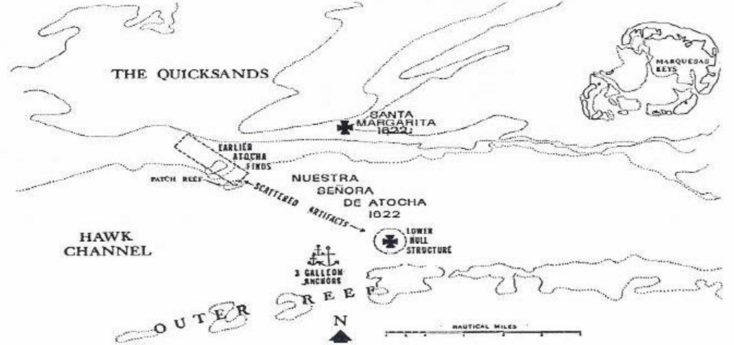


September 16, 1622
July 20, 1985
$400M, but… 263 years.
Notes:
Nuestra Señora de Atocha ("Our Lady of Atocha“) sank in 55 feet of water southwest of Key West, FL.
Mel Fisher and a bunch of investors searched the seabed for 16.5 years using traditional search grid techniques and found the ship on July 20, 1985.
As with most wrecks, the wreckage was very dispersed because of time to sink, breakup before sinking and currents. This was a well-known pattern to shipwreck hunters.

Slide 5
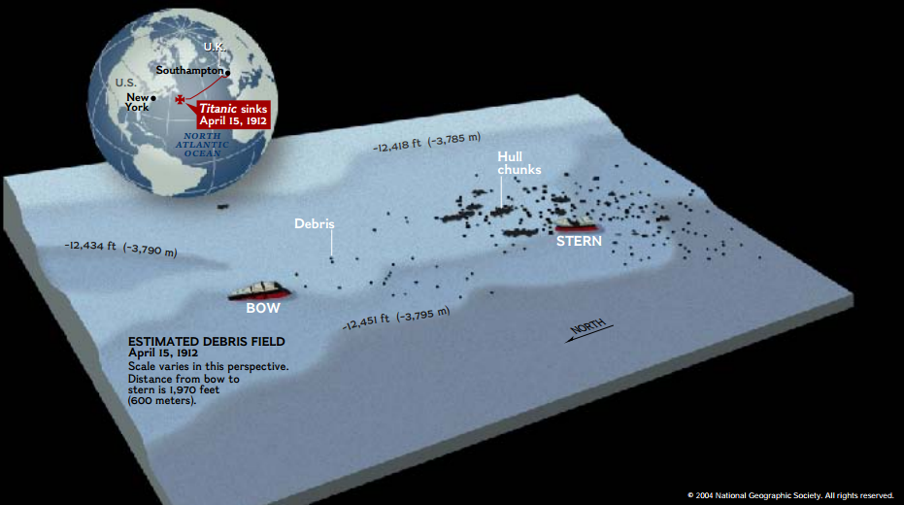
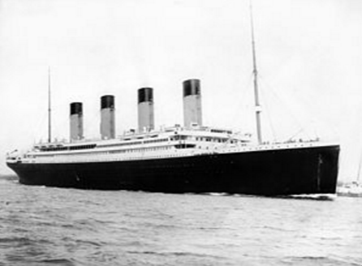

April 15, 1912
September 1, 1985
72 years
Not 2 months after the Atocha was found…
Notes:
When the Titanic was found after 72+ years, the wreckage followed the same distributed pattern.
The Titanic was found just 2 months after the Atocha…
Same pattern, approximately the same amount of knowledge about its location.

Slide 6
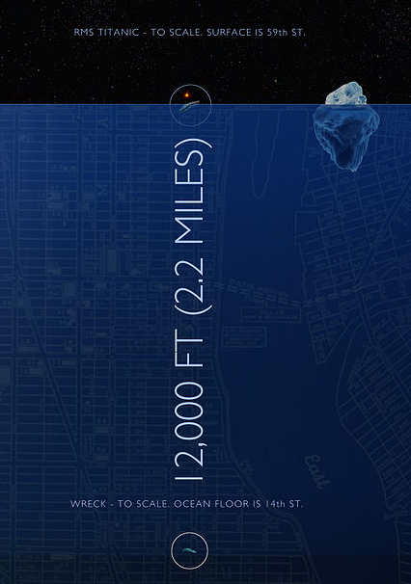

A little knowledge and new techniques will find your treasure much faster.
And you have a LOT of knowledge.
Notes:
However, the Titanic was in 12,000 feet of water, while the Atocha was in 55 feet of water.
Why was the Titanic found so “quickly”?
It was the application of new technologies to the knowledge of the approximate location and dispersal patterns that overcame the huge challenge of depth.
So, new techniques and technologies applied with knowledge can help you find your treasure much faster.
And you have a LOT of knowledge.
But where do we find our treasure?

Slide 7
Example Value Targets Start here. What’s valuable to you?
Business Area
Business Capabilities
Value Targets
Customer Insight
Customer Acquisition
Cross-sell and Up-sell
Customer Churn
Loyalty
Personalization
Customer acquisition rate: 10 – 30%
Lift per campaign: 10 – 250%
Customer value: 5 – 15%
Churn Rate: 5 – 20%
Operating Income: 2.5 – 3%
Marketing Performance
Marketing Return on Investment
Campaign Profitability and Optimization
Marketing Mix Optimization
Media Mix
Improvement in ROI: 14%
Reduction of agency fees: 5%
Improved Media Productivity: 7%
Operating Efficiency
Efficiency
Innovation
Regulatory/Compliance
Risk
People and Capability
Revenue per Employee: 5%
MTTR: 10%
On Time Commit to Delivery: 7%

Slide 8
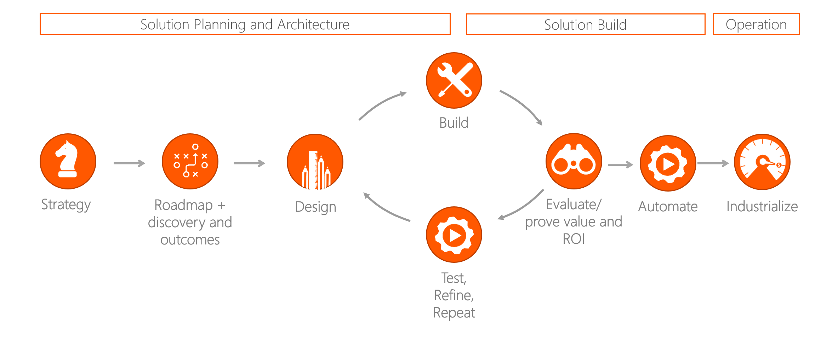
The New Technique: Investigate, Automate, Industrialize
Before you start, review the 6 Guiding Principles.

Slide 9
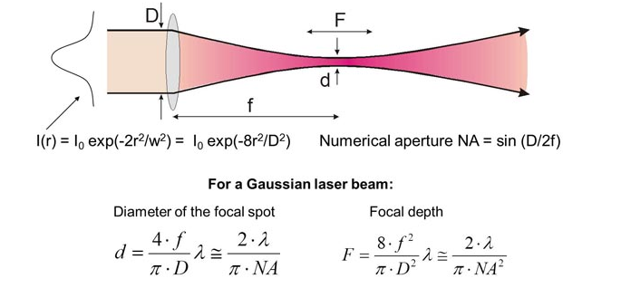
Guiding Principle #1
Be laser-focused on outcomes.
https://www.aao.org/munnerlyn-laser-surgery-center/basic-laser-properties

Slide 10
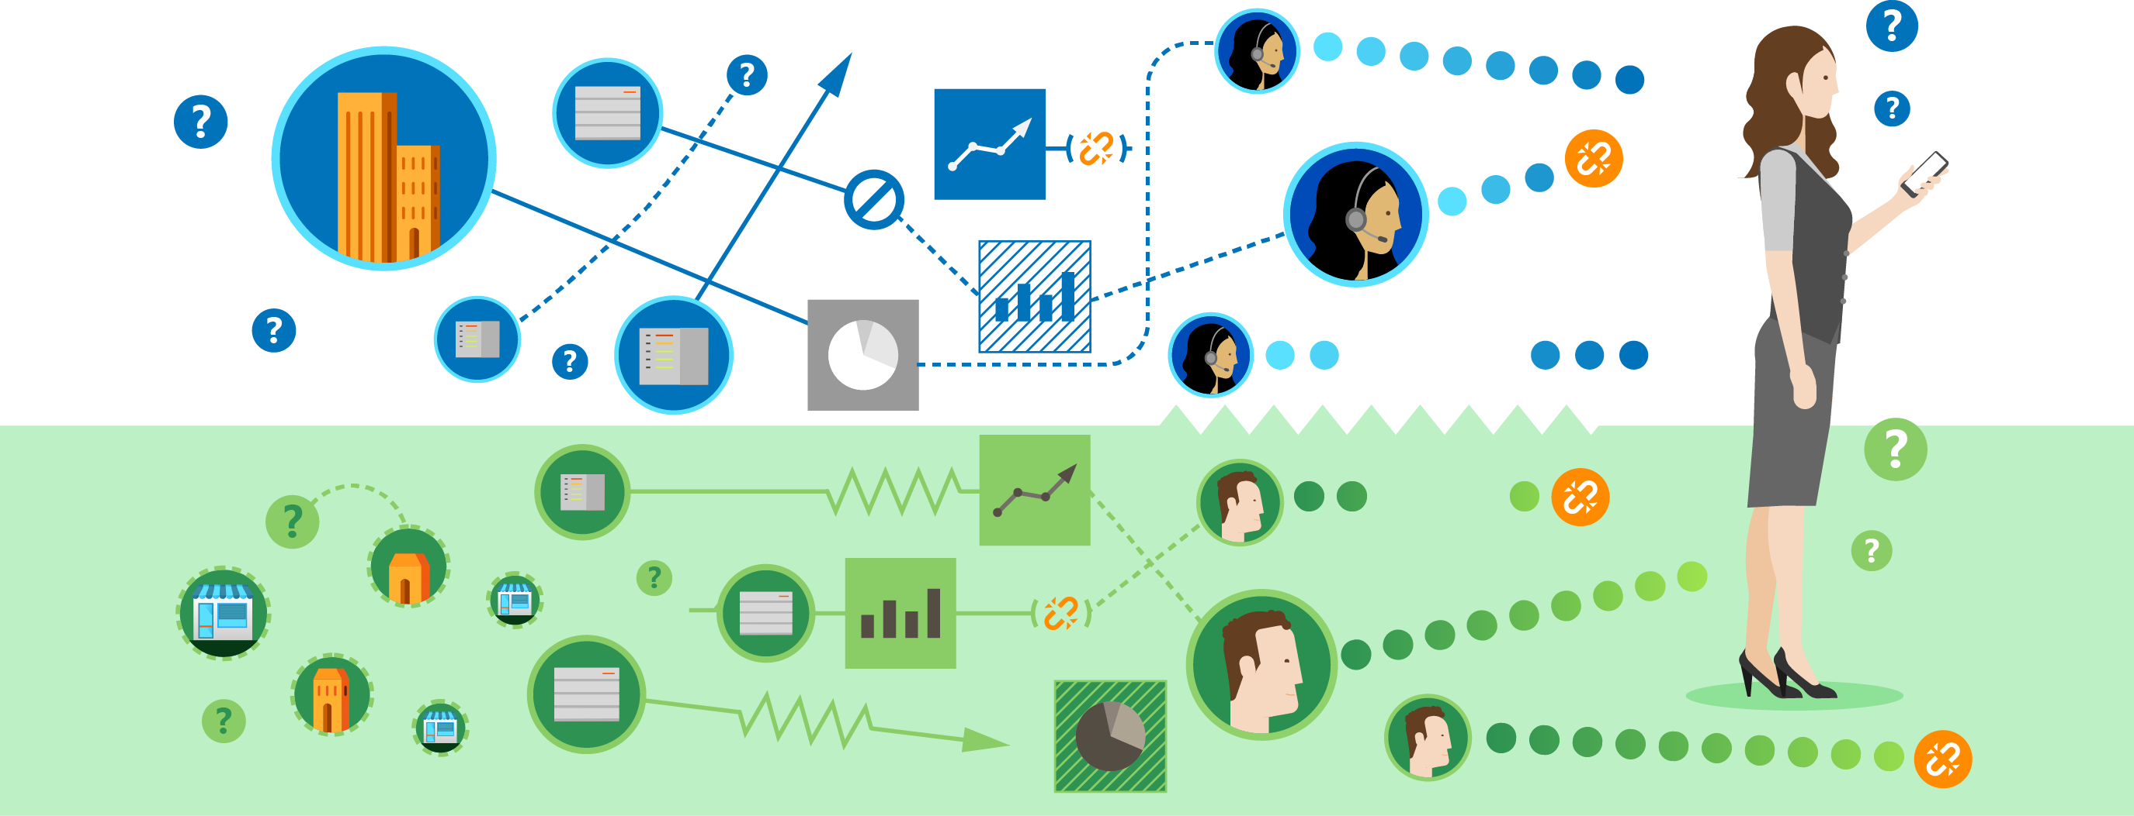
Guiding Principle #2
The integrated “exhaust” from every customer and process interaction is a cash-equivalent asset.
Divided Analytics
Service
Sales
Notes:
Co-creation of experiences: two-way process. Customers are part of creating the experience. Whether that’s measuring behavior or engaging them. Job of service people and salespeople to help create that experience. Stickiness increases.
Blips for the core sales/run model

Slide 11
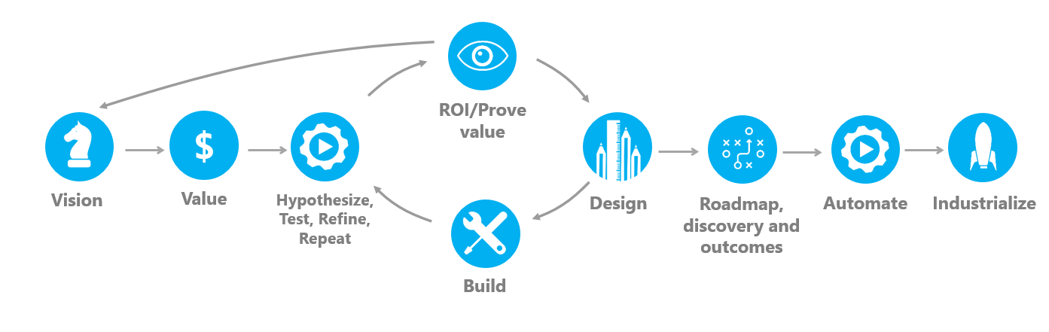
Guiding Principles #3 and #4
Action ≡ Value ≡ Vision
A ≡ V ≡ V
#3: Action if and only if Value if and only if Vision
#4: Investigate, Automate, Industrialize

Slide 12

Guiding Principle #5
Don’t build an Olympic Monument
Notes:
Cycling stadium 2008 Olympics in China. Now used to teach kids to drive.
Billions of dollars of investment sits empty and derelict
This is what happens if you build for one purpose.

Slide 13

Guiding Principle #6
Reading dashboards and scorecards without the ability to take immediate action
Is like having a dashboard without a steering wheel.

Slide 14
Insight Discovery Workshop Approach: An Example
Step 1
Vision, Value
Step 2
Test, Refine, Repeat
Create the Vision
Data
Understanding
Hypothesis 1
Introduction to the IDW approach
Understand business imperatives
Build consensus on topics, benefits, and fit for purpose
Prepare
Models
Run
Models
Evaluate
Models
Validate ROI
Re-Run Models
Evaluate
Results
Data
Preparation
Iterate and refine
Hypothesis n
Define the Value
Prepare
Models
Run
Models
Evaluate
Models
Validate ROI
Re-Run Models
Evaluate
Results
Literature Reviews
Select initial hypotheses
Prioritize top hypothesis by:
Potential ROI
Data Availability
Ability to Act
Impact to the Business
Define success and exit criteria
Iterate and refine
Evaluate Future ROI
Create Automation Roadmap

Slide 15
Vision
1. Understand the business problem
We really have no way of knowing if our products improve the outcomes of health department evaluations. We know our products are effective, but how effective are they really?
2. How might you solve it?
Being able to draw statistically-significant conclusions from our product sales data (maybe combined with other 3rd party data sets?) would be a good start. No matter how the investigation turns out.

Slide 16
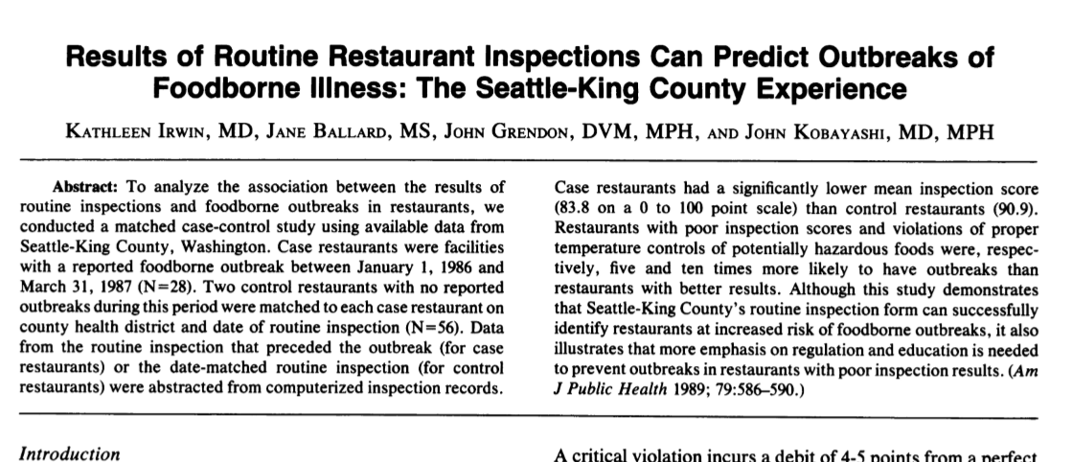

Literature Review

Slide 17
Evaluate Hypotheses
Hypothesis | Potential ROI | Data Availability | Ability to Act | Impact to the Business
Lower-than-average product sales for individual customers in some period before an evaluation negatively affect that evaluation’s outcome. | 5 | 5 | 4 | 4
Hypothesis #2
Hypothesis #3

Slide 18

Are you ready? A simple checklist.
The hypothesis is sharp
The hypothesis matters
The data is accurate
The data is connected
There’s a lot of it
“Component x on Model y will fail in the next 30 days.”
KPIs and/or empowered actions based on the output.
Business trusts the available data accurately reflects the relevant observation.
Data can be linked across systems and use cases; silos can be torn down.
Accurate prediction or trend discovery is difficult with few examples.

Slide 19







The New Technique: Investigate, Automate, Industrialize
ROI/Prove value
$
Vision
Value
Hypothesize,
Test, Refine, Repeat
Design
Roadmap, discovery and outcomes
Automate
Industrialize
Build

Slide 20
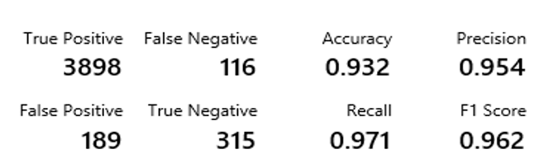
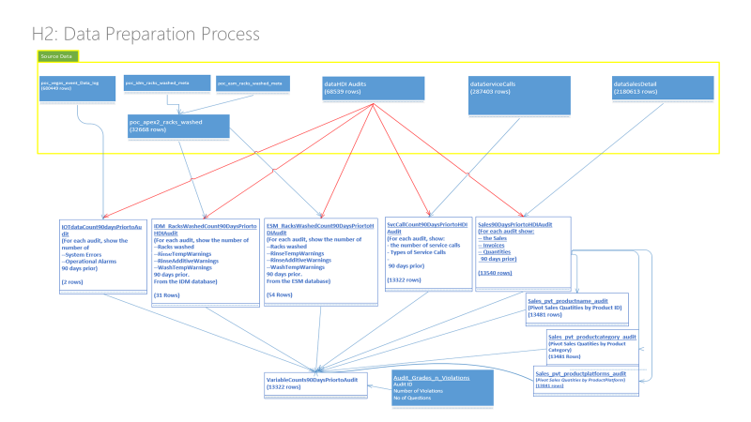
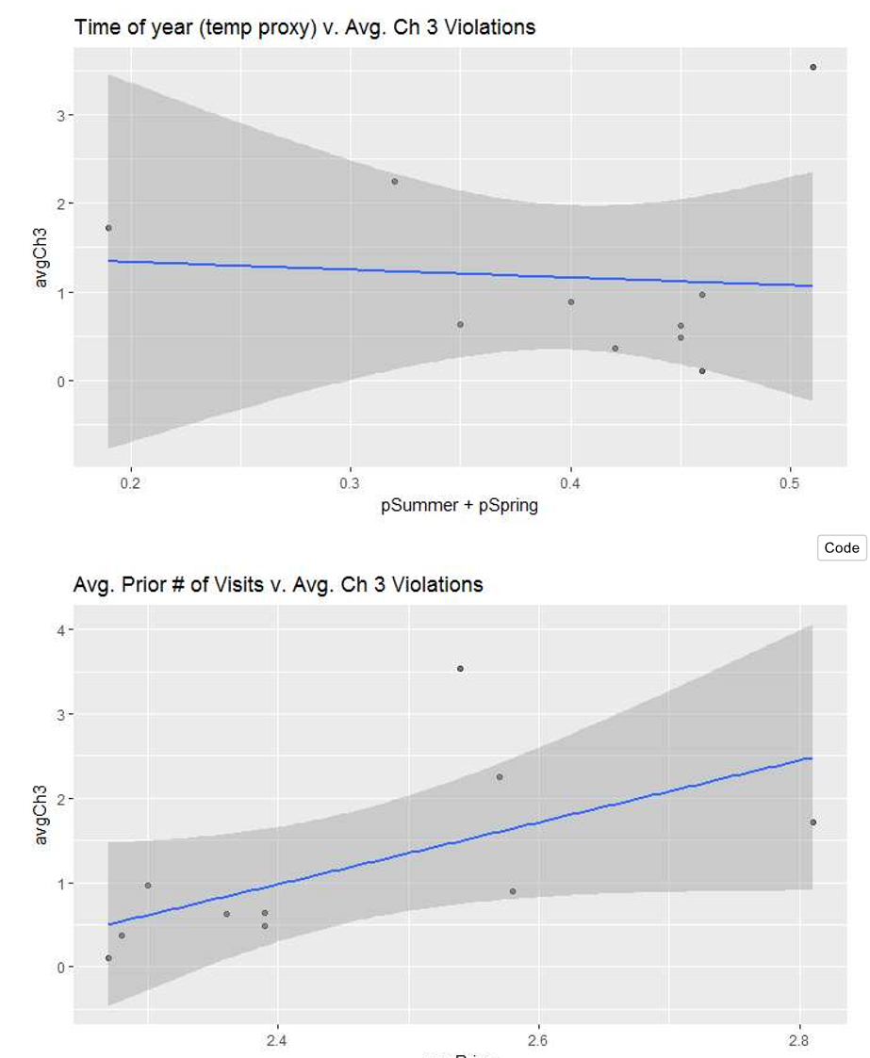
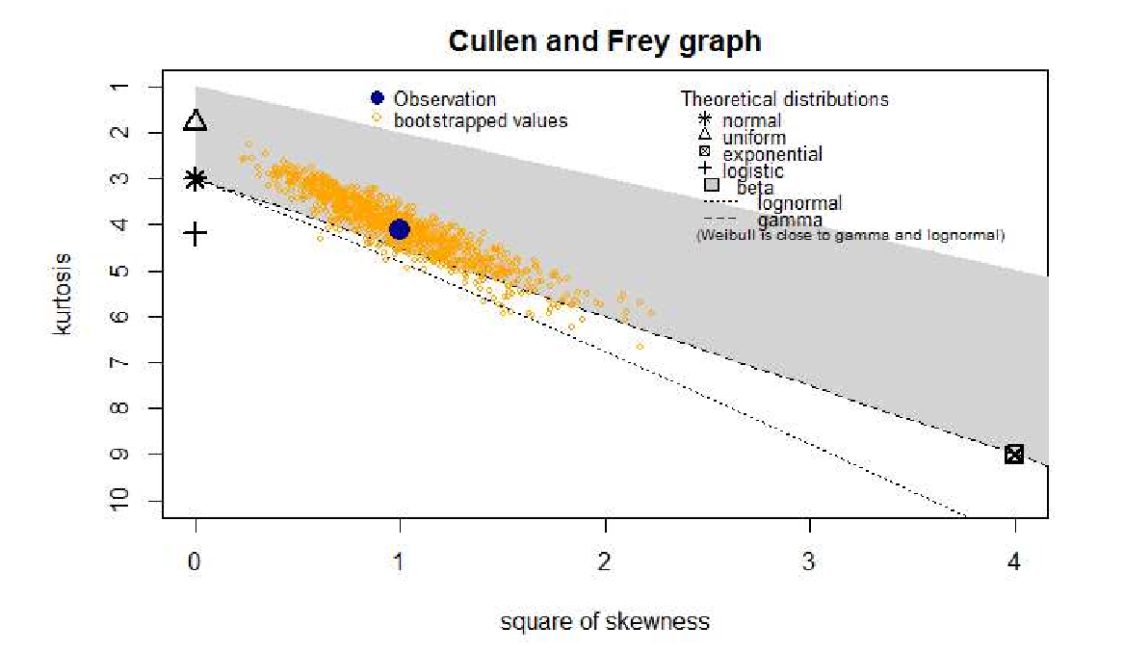
Test, Refine, Repeat

Slide 21
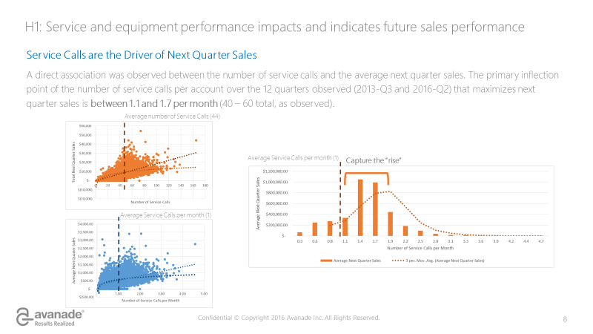
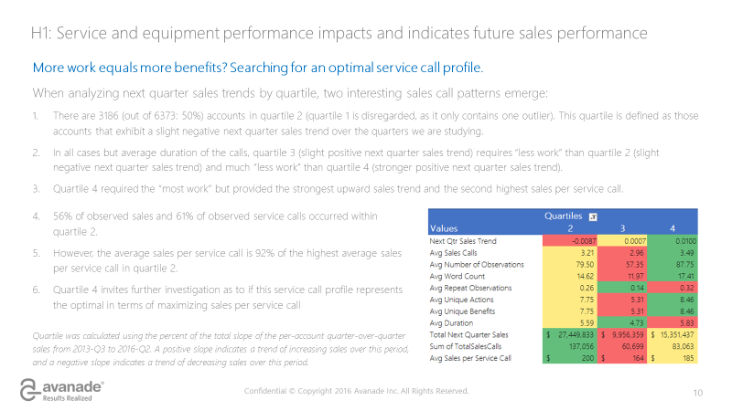
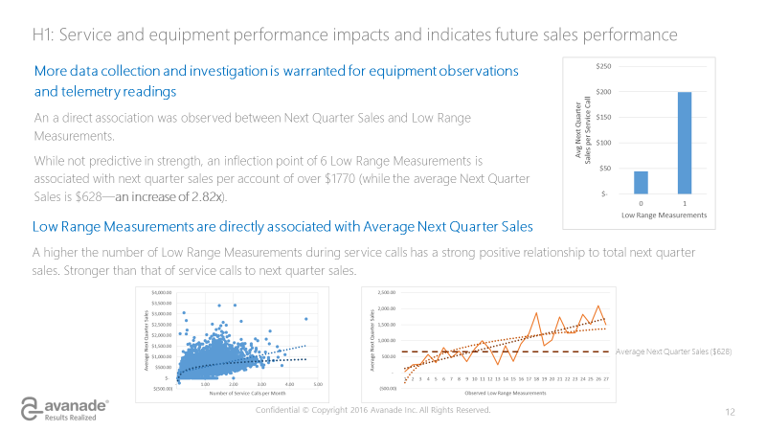
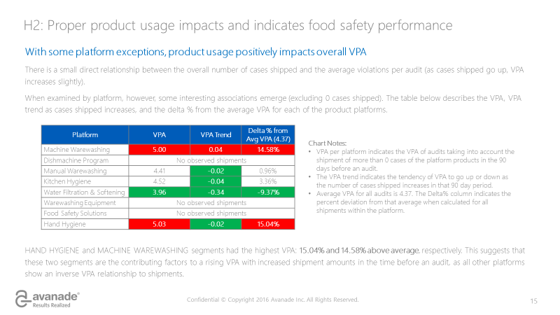
Presentation of Results

Slide 22
The New Technique: Investigate, Automate, Industrialize
ROI/Prove value
$
Vision
Value
Hypothesize,
Test, Refine, Repeat
Design
Roadmap, discovery and outcomes
Automate
Industrialize
Build

Slide 23
How can we put this to practice?
Client Stories

Slide 24
The Largest Swedish Insurer
Proving Rapid Value by building machine learning models to discover previously unknown insights

Slide 25

THE ASK
To support the client’s Customer Intelligence initiative to gain significant insights by leveraging an agile approach that enables rigorous analysis of customer data for making correct and timely business decisions
To DEMONSTRaTE the EASE OF CREATING PREDICTIVE MODELS FROM RAW DATA
To Find insights in the raw data that are currently not known and which have not been discovered
To Assess the fit of a future solution to The clients environment
To create a resilient customer data environment that provides the foundation for advanced analytics
Notes:
Some background info from the customer
Effective handling of customer data is key to developing business, reducing churn and improving business performance. Codan/Trygg-Hansa has launched a Customer Intelligence initiative in order to pursue a resilient customer data environment that provides the foundation for advanced analytics. Furthermore, the objective is to gain significant insights by leveraging an agile approach that enables rigorous analysis of customer data for making correct and timely business decisions.
Codan/Trygg-Hansa has already identified areas such as customer acquisition, customer retention, customer satisfaction, channel optimization, etc., where customer intelligence can play a significant role with the aim to:
Increase customer acquisition rate
Increase cross selling
Reduce customer churn
Increase customer satisfaction
Increase new premium revenue
Codan/Trygg-Hansa has expressed an interest to conduct a discovery workshop with Microsoft to narrow down the scope of pilot focused on ‘Customer Touchpoint Analysis’. Following list of topics to be further discovered i.e.,
Business
Increasing New Premium business through customer acquisition and/or x-sell/up-sell
Reducing Policy Lapses by predicting customer churn across different product lines
Technology
Feasibility of central customer data repository for analytical purposes
Validation of in-scope data sources / touch points i.e., Campaigns, Products, Customers, Quotes, Call Guide, Events, Web, Claims, External data, etc.

Slide 26
A 3 week agile approach was used for delivery: an Insight Discovery Workshop was the foundation and starting point to collaboratively define business challenges and the POC focus
FROM INSIGHT TO ACTIONS
FROM DATA to INSIGHT
Discover
Insights and recommendations for business actions
Linking the Predictive Models to the client’s ACAI Environment
Set Up & Installation of the ACAI environment
Creation of the Customer Analytical Record: A Single Customer View
Building Machine Learning Models on lapse prediction, quote analysis and car sell prediction
Insight Discovery Workshop
Understanding existing business issues and challenges, conducting a data assessment
Conceptualizing and prioritizing predictive models and their scope

Slide 27
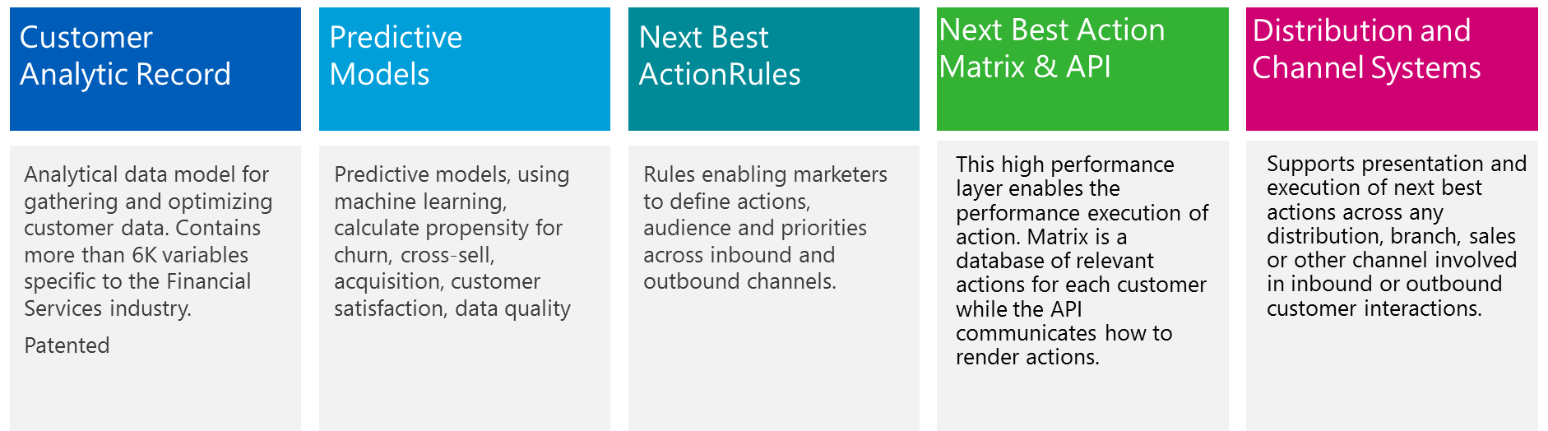
Avanade delivered a proof of concept that focused on the “Data to Insights” pillars of the ACAI framework, with a roadmap to transform the insights generated to action
From Data to Insight
From Insight to Action
PoC Focus Area and Scope

Slide 28
DISCOVER
Models were conceptualized and prioritized in collaboration with the client over the kick off IDW: three of these models were chosen for the POC based on a detailed data assessment
Priority 1. Quotes Exploratory Analysis
Which quotes should b be acted on and which would convert anyway?
How and by which channel?
Priority 2. Reducing Policy Lapses by predicting customer churn across different product lines
What are the most common products and triggers for first lapse?
Priority 3. Predicting “Moments of truths" /Triggers
Example: Starting college need home insurance
Priority 4. Prediction of Car Selling
When is a customer most likely to sell their car?
Priority 5. Which customers are most likely to convert or need a marketing message post a new car purchase?
Priority 6. Exploratory analysis and a predictive model to use the claims process as a retention trigger
Priority 7. Preventing claims via proactive alerts for high risk events
Reaching out to customers before a storm hits
Specific car models are stolen more frequently?

Slide 29
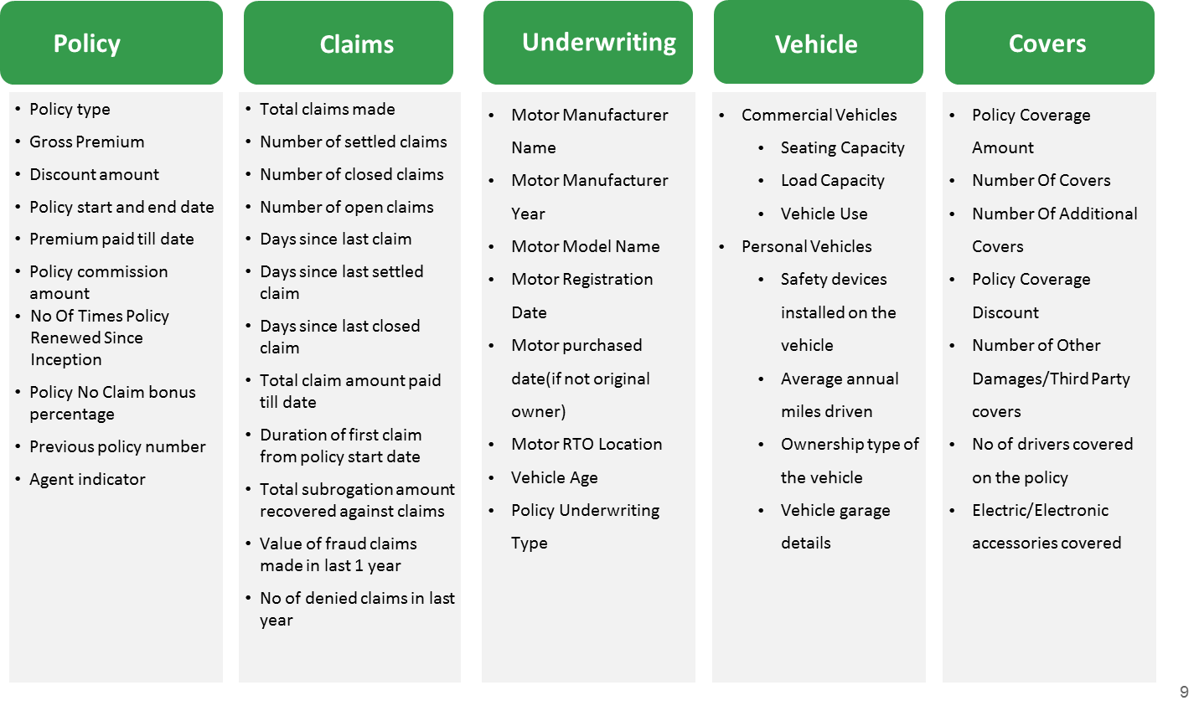
FROM DATA TO INSIGHT
Post the IDW, the first step was to set up the POC analytical environment and build the CAR model that would be the foundation for machine learning and exploratory analysis
Setting up the POC Environment
Building & Populating the CAR Model
Uploading files to the server in Azure
Setting up of a new cloud based virtual machine
Installing necessary software and tools on VM
Creating the databases needed for ACAI
Setting up a web project for the ACAI interface
Restricting access and publishing ACAI
Collecting the data physically from the client’s office consisting of 14 files (tables):
10 transaction data tables
4 dimensional/meta data tables
Approximately 260 million rows / 22 GB
Loading data files into a staging database without transformation
Creating views to aggregate the data and creating “CAR-friendly” data
Loading the data from these views into 6 CAR dimensions with a total of 300 columns/attributes

Slide 30
FROM DATA TO INSIGHT
The lapse prediction model determined key risk factors and triggers for lapse, including those that differed and remained similar across segments
What drives Motor policy lapse due to non payment of new policies?
What drives Motor policy lapse due to the insurance need ending?
Policy Type P1 and P3
High Risk
Recent Policy Purchasers
High Risk
Policy Types DK, HB, SR, TR, VA
Low Risk
Multiple Active Motor Policies
High Risk
Higher Motor Premiums
High Risk
12 Months Payment Term
Low Risk
Additional Policies Coming Up to Maturity
High Risk
Open Motor Policy Claims
High Risk
Previously Lapsed Motor Policies
High Risk
Older Customers
Low Risk
Not Willing to be Contacted by Phone
High Risk

Slide 31
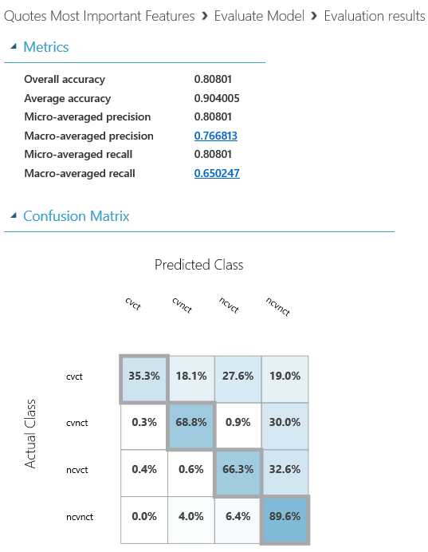
FROM DATA TO INSIGHT
The quote machine learning model indicated that quotes from customers with no active house policies and fewer products benefited the most from a follow up contact
Have bought a policy in the last 24 months
Have no active house policies
Have a low number of active policies
The quote prediction model classified quotes into 1 of 4 categories to determine which quotes should be followed by a contact
Contact customers who quote and..
No. Of Quotes | Contacted | Not Contacted | Total
Converted | 416 | 5 117 | 5 533
Not Converted | 8 454 | 22 717 | 31 171
Total | 8 870 | 27 834 | 36 704
Customers with a high potential to convert without a contact are..
Those who quote for a low net premium
Quotes for hc_product 033
Customers with no or less lapsed policies, especially when they have no house policies with a renewal lapse
Are quotes for a high net premium
Customers whose last motor insurance policies were for car trailer models FÅGELSTA-SLÄPET or FOGELSTA
Quotes that do not convert but should be paid attention to..

Slide 32
FROM INSIGHT TO ACTIONS
The POC led to several insights that the client didn’t know before and which can now be leveraged to drive retention and higher conversion rates
1
2
3
4
5
Higher value motor policies lapse more
Customers who have an additional policy that has a maturity expiry date coming soon are more likely to lapse from their motor policies
Customers who are not willing to be contacted via telephone also tend to lapse more
Customers who quote and have no home policy convert more easily with a follow up contact
Frequent lapsers and customers with open motor claims are more likely to terminate their motor policies mid term

Slide 33
FROM INSIGHT TO ACTIONS
The lapse prediction model scores in conjunction with policy value also provided a framework to target and retain high risk-high value customers
Low Risk-High Value (LRHV)
High Risk-High Value (HRHV)
Lapse Risk Scores: 0% - 59%
Premium: 5,001 SEK and above
% Total Customers Lapse 1 Customers: 26% (100,559 customers)
Total Customers Lapse 2 Customers: 22% (86,387 customers)
Lapse Risk Scores: 60% - 100%
Premium: 5,001 SEK and above
% Total Lapse 1 Customers: 1% (2,543 customers)
% of Total Customers Lapse 2 Customers: 4% (16,715 customers)
High Value
Strategy: Protect & nurture customers in each respective lapse category to avoid lapse in the other one
Strategy: Convert & Retain. Prioritize customers with high risk triggers such as younger, frequent lapsers across both categories, policy types P1 and P3 for Category 1 and customers with open motor claims and multiple motor policies for Category 2.
Risk
0%
Low Risk-Low Value (LRLV)
Risk : 59%
Premium: 5,001
High Risk-Low Value (HRLV)
High Risk
100%
Lapse Risk Scores: 0% - 59%
Premium: 0 to 5,000 SEK
% of Total Lapse 1 Customers: 71% (276,764 customers)
% of Total Customers Lapse 2 Customers: 56% (219,055 customers)
Lapse Risk Scores: 60% - 100%
Premium: 0 to 5,000
% Total Lapse 1 Customers: 2% (8,871 customers)
% of Total Customers Lapse 2 Customers: 18% (66,580 customers)
Strategy: Increase value, testing bed. Specifically using the 3,342 contactable customers who have a medium risk profile (40%-60%) and premiums above 1,500 SEK for Lapse category 1 and the 13,195 contactable customers with the same profile in Lapse category 2
Low Value
Strategy: Lowest in priority, develop specific segments e.g. the 4,376 customers who have a Lapse 1 risk of 80% and above and have a premium above 1,500 SEK and the 32,211 customers who have a Lapse 2 risk of 80% and above and have a premium above 1,500 SEK
Premium
0

Slide 34

Boiler Failure Volume Forecasting for Baxi, UK

Slide 35

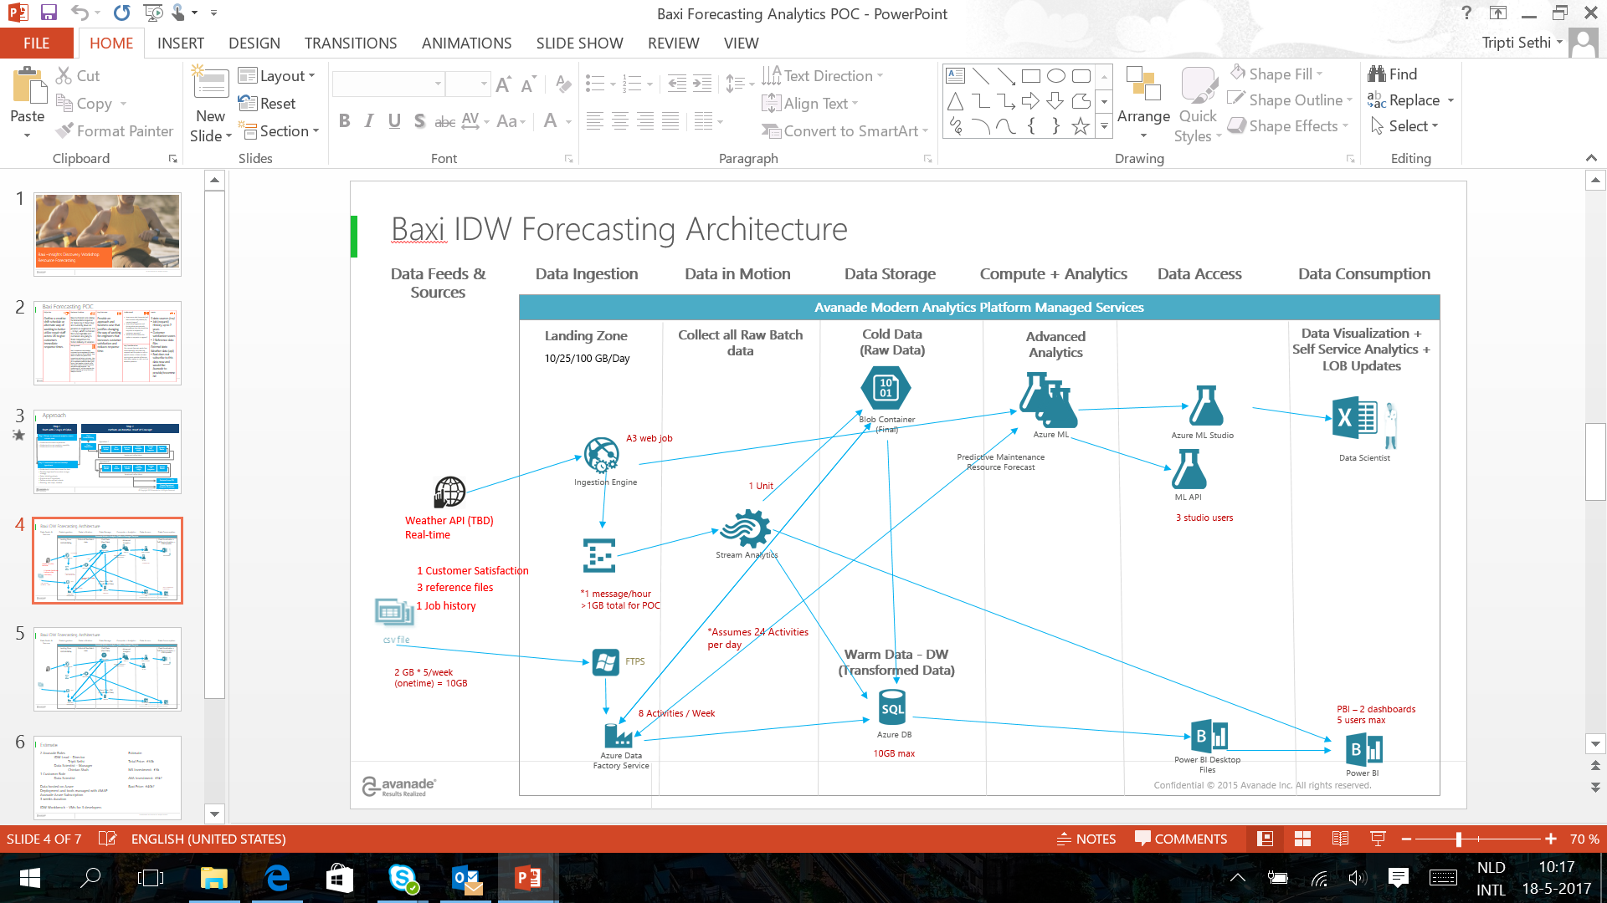
What makes the Baxi story special?
Initialize &
Scoping
Data Preparation &
Transformation
3 weeks Insight Discovery Approach
Business outcome &
visualization
Machine learning

Slide 36


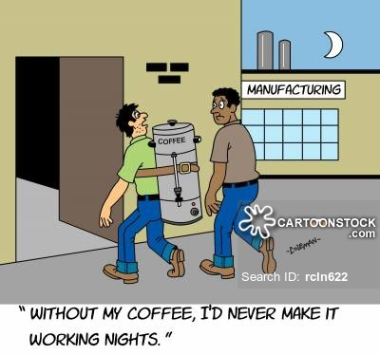
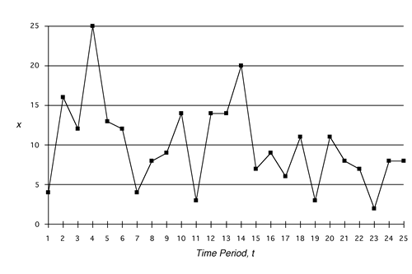
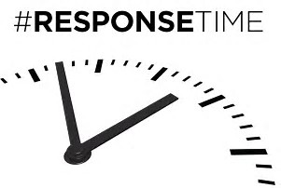

Why predictive analytics on boiler failures?

Slide 37


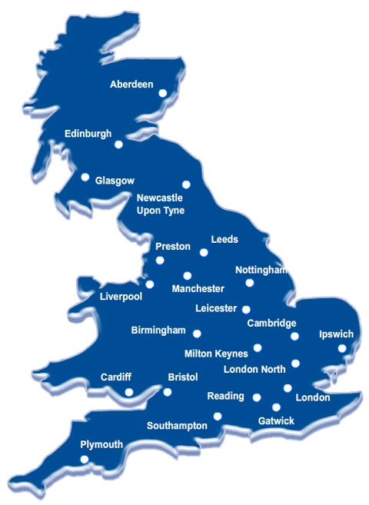

The starting point was Baxi’s existing boiler failure forecast
Bi-Annual Forecasts
A Single UK Forecast
87%

Slide 38
The Ask
1
2
3
4
Improve the boiler failure job volume forecasting model to predict by day, urgency and region
Show impressive accuracy statistics and insights not previously known
Rank the most important factors driving the forecast
Compare the accuracy of the new forecast vs. existing forecast
Scope
Avanade Success Factors
Bringing region granularity into the job volume forecasting
Actionable insights for the business, e.g. estimated jobs by time of the year, no impact of weather> 3º
Triggers driving forecast accuracy and their relative importance
Increased value and ROI through increased accuracy
Create a robust boiler failure job volume forecast and insights by region that allows for more efficient engineer scheduling, reduces response time and ultimately drives customer satisfaction

Slide 39
How did we get here?
An agile, three week, discovery based collaborative approach
Start with the end in mind, learn rapidly and evolve thinking
Setting You up for Success
Making it Real & Learning Continuously
Enriching Data & Designing Modelling Approaches
Mobilise
First triggers lead to new approach to weather data
Making it real – first results
Final models, automation & handover
_{Final} _{presentation & value}
Collaborative sessions at critical milestones
_{Kick off workshop}
_{Days 3-4}
_{Data Discovery & Set up}
_{Days 5-9}
_{Investigate & Analyze}
_{Days 10-14}
Forecasting Models Approach & First Views
_{Days 15-16}
_{Final Forecasting Models}
_{Days 17-18}
Automating the Models & Knowledge Transfer
_{Day 19}
Final Presentation, Value Generated
_{Days 1-2}
_{Assess & Scope}
Notes:
Align Establish long-term strategic objectives
These kinds of conversations happen once if not twice a year, and they're very important because it guides what the company does. It sets the stage for what we should be working on, and what we shouldn't be working on.
Align a team on mid and long-term priorities
Routinely organizations find themselves in situations where people aren’t necessarily aligned, both in terms of having a shared understanding of what the current situation is, and also making sure that they’re pointed in the right direction
It's not so much what's on somebody's agenda — it's more what's on the group's agenda. That's the whole idea when you're trying to gain alignment with a team on the problems to go after.

Slide 40
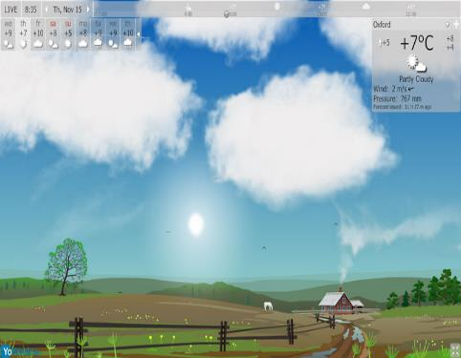
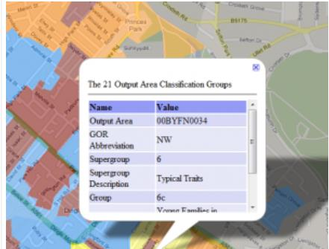
Data Enrichment
Job Request & Sales Data
Weather Data
Regional Splits
Temperature (high/avg/low)
Dew Point (high/avg/low)
Humidity % (high/avg/low)
Sea Level Pressure (high/avg/low)
Visibility (high/avg/low)
Wind (high/avg/low)
Precipitation
Indicators for rain, fog, thunder, snow & rain
Output Area Classification Data
Regions aligned to Met office regions
Combining smaller regions for statistical significance
Splitting out larger regions with large job volumes: London, South East & South Central
76 Socio demographic segments called output area classifications based on postcodes and Census data
Source: https://www.wunderground.com/

Slide 41



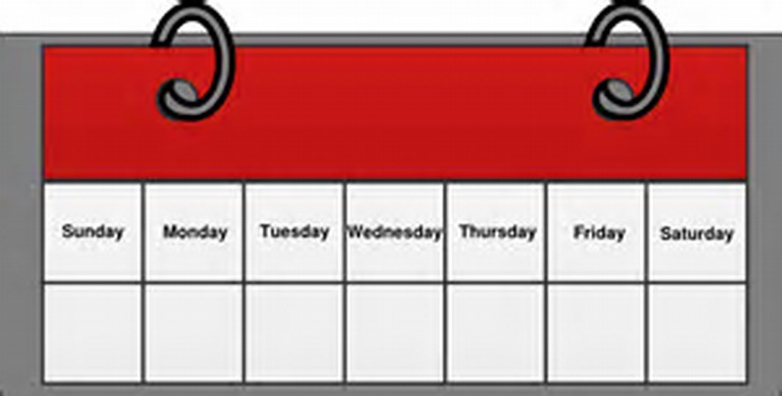
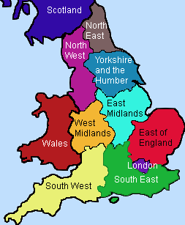
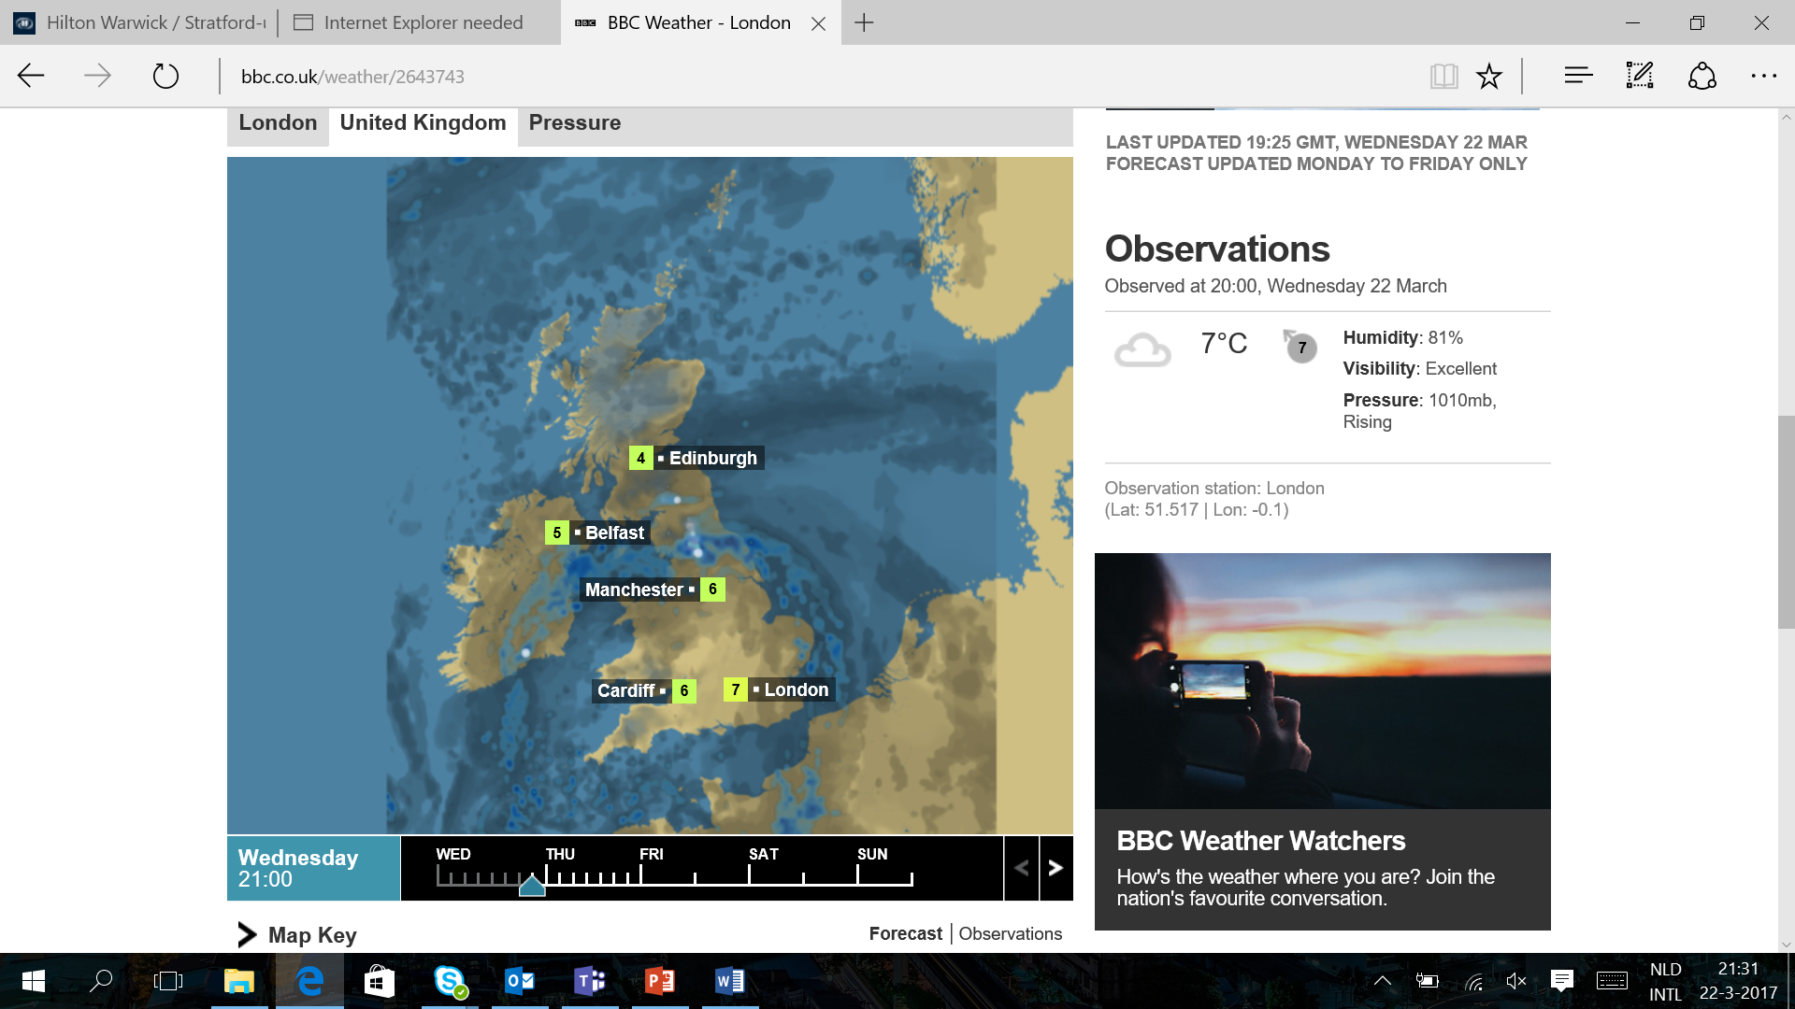
Rapid insight comes from foundational hypothesis
1
Its Cold!
3
Pay for Better Service
2
Cranky Mondays
4
Sunny in London, Freezing in Edinburgh

Slide 42
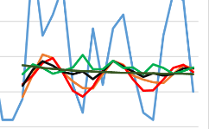


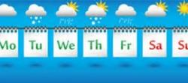
Blended Forecasting Models: 450 models for 14 UK regions
1. Base seasonal and non seasonal forecasting models
2. Forecasting model including top weather parameters
3. Forecasting models for each day of the week
4. Repeat steps for urgent vs. non urgent requests
All previous forecasts by SLA groups
Optimally blend the models together to have one final forecast per day
Forecasts for Mondays only, Tuesdays only, etc.
20% of Base Model Forecast
Greater Granularity = Greater Accuracy
Daily Forecast with Weather
40% of Weather Model Forecast
Base Daily Forecast
40% of Day of the Week Model Forecast
14 UK Regions = approx. 450 models!
Note: Base models were used for Highlands and Islands and Northern Ireland as they represent only 1% of total intake volume

Slide 43
Regional Forecast Summary
Cluster 1: Consistent Regions (+4%)
Cluster 2: Under Predicting Regions (-16%)
Regions: London, South Central, East, North East & East Midlands
52% Intake Volume
Range of Difference: 1% (East of England) to 7% (North East England & East Midlands)
Forecast Drivers:
Weather: London, South Central
Blend of Weather & Seasonality: East, North East & East Midlands
Days of the Week: South East
Regions: South East, South West England, Strathclyde & Northern Ireland
19% Intake Volume
Range of Difference: -11% (South West England) to -27% (Strathclyde)
Forecast Drivers:
Weather: South West, Strathclyde
Blend of Weather & Days of the Week: South East
Cluster 3: Over Predicting Regions (+12%)
Regions: North West, West Midlands, Yorkshire & Humber, Wales, Highlands & Islands
29% Intake Volume
Average % Difference from Actuals: 12% (excluding Highlands & Islands)
Forecast Drivers:
Weather: West Midlands, Yorkshire & Humber
Blend of Weather & Days of the Week: North West
Days of the Week: Wales
Note: Bank holidays (25th Dec, 26th Dec and 1st Jan) were excluded from the analysis, Predictions are from 17th Dec 2016 – 19th Jan 2017
Notes:
Highlands and Islands difference from actuals is 517% but in jobs is only 6,33 jobs. It is 1% of the intake volume

Slide 44
Ranking Forecast Triggers
Ranking | Parameter | Forecasting Error Reduction
1 | Fog | 6.4%
2 | Total Expiring Warranties | 5.9%
3 | Average Wind Speed | 5.5%
4 | Snow | 5.5%
5 | Average Humidity | 5.4%
6 | Total Appliances Sold | 5.4%
7 | High Humidity | 5.3%
8 | High Wind | 5.3%
9 | Rain | 5.2%
10 | Average Sea Level Pressure | 5.2%
11 | Difference between total sold and expiring warranties | 5.2%
12 | Thunder | 5.2%
13 | High Sea Level Pressure | 5.1%
14 | Low Sea Level Pressure | 5.1%
15 | Low Temperature | 5.1%
Combinations | Forecasting Error Reduction
Putting all Descriptors | -1%
Top 15 | 9%
Top 10 | 2%
Top 5 | -2%
Best of Each | 10%
Fog has the highest impact on forecasting intake volume followed by wind
Despite multiple triggers driving intake volume individually, a combination that does not repeat similar parameters yeilds better overall results
Total expiring warranties also has an impact in the intake volume
Note: Analysis based on SLA Group C and HP postcode area

Slide 45
Previously unknown insights: the “Aha” moment for Baxi
1
2
3
4
5
Fog and wind speed are top triggers driving job requests
Weather does not impact every region in the same way
Temperature does not impact job requests in any significant way
A regional forecast is not only possible, it also increases accuracy
Non-urgent requests are not affected by weather

Slide 46
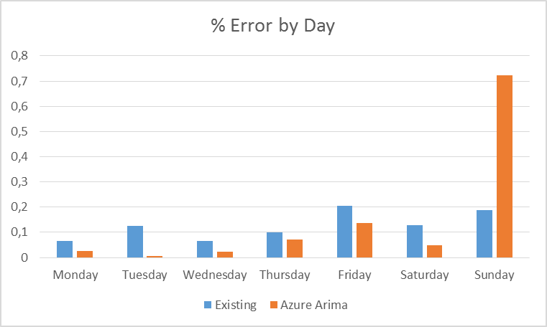
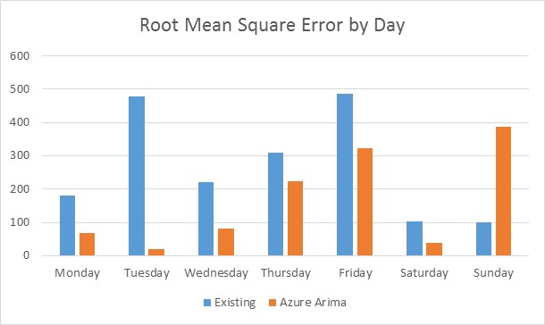
A new forecast accuracy of 98%
What does this tell us?
This amounts to an overall accuracy of 98% (+2% over prediction) by the new forecast vs. a 87% accuracy (-13% under prediction) in the existing forecast, an uplift of 11%
The new forecast minimizes error for all days except Sunday which needs to be evaluated further
Note: Forecast comparisons done at a national level using dates from 2nd January 2017-19th January 2017

Slide 47

Revisiting the Asks
1
2
3
4
Improve the boiler failure job volume forecasting model to predict by day, SLA group and region
Show impressive accuracy statistics and insights not previously known
Rank the most important factors driving the forecast
Compare the accuracy of the new forecast vs. existing forecast.
Region, day of the week and level of urgency granularity included in forecasting
Actionable insights generated for Baxi through the forecasting process
Stack Ranking of triggers driving forecast accuracy along with their combinations
98% accuracy of the new forecast vs. 87% for the existing forecast, £96K saving opportunity

Slide 48
AMAP ensures model deployment and re-usability
Upload Job Data
Get Weather
Run Forecast
Current Strategic Planning Infrastructure
Automated forecasting models
Free weather data API
Models are in Azure designed to easily transition to production
Notes:
Upload job data to Azure
Get weather history from [where] with free API
Run Forecasting Model for Region
Analyse and Smooth the Data
Use to forecast Job Requests!

Slide 49

£96K savings opportunity over a year on staffing costs
Subcontractor Spend
£96K
Overtime
Engineer Hiring
Improved Customer Satisfaction, Loyalty & Reduced Complaints

Slide 50




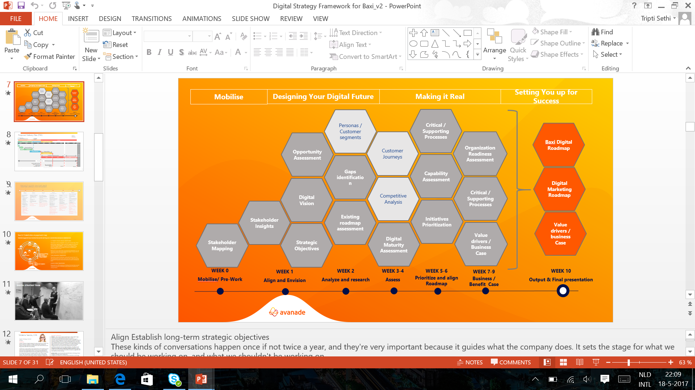



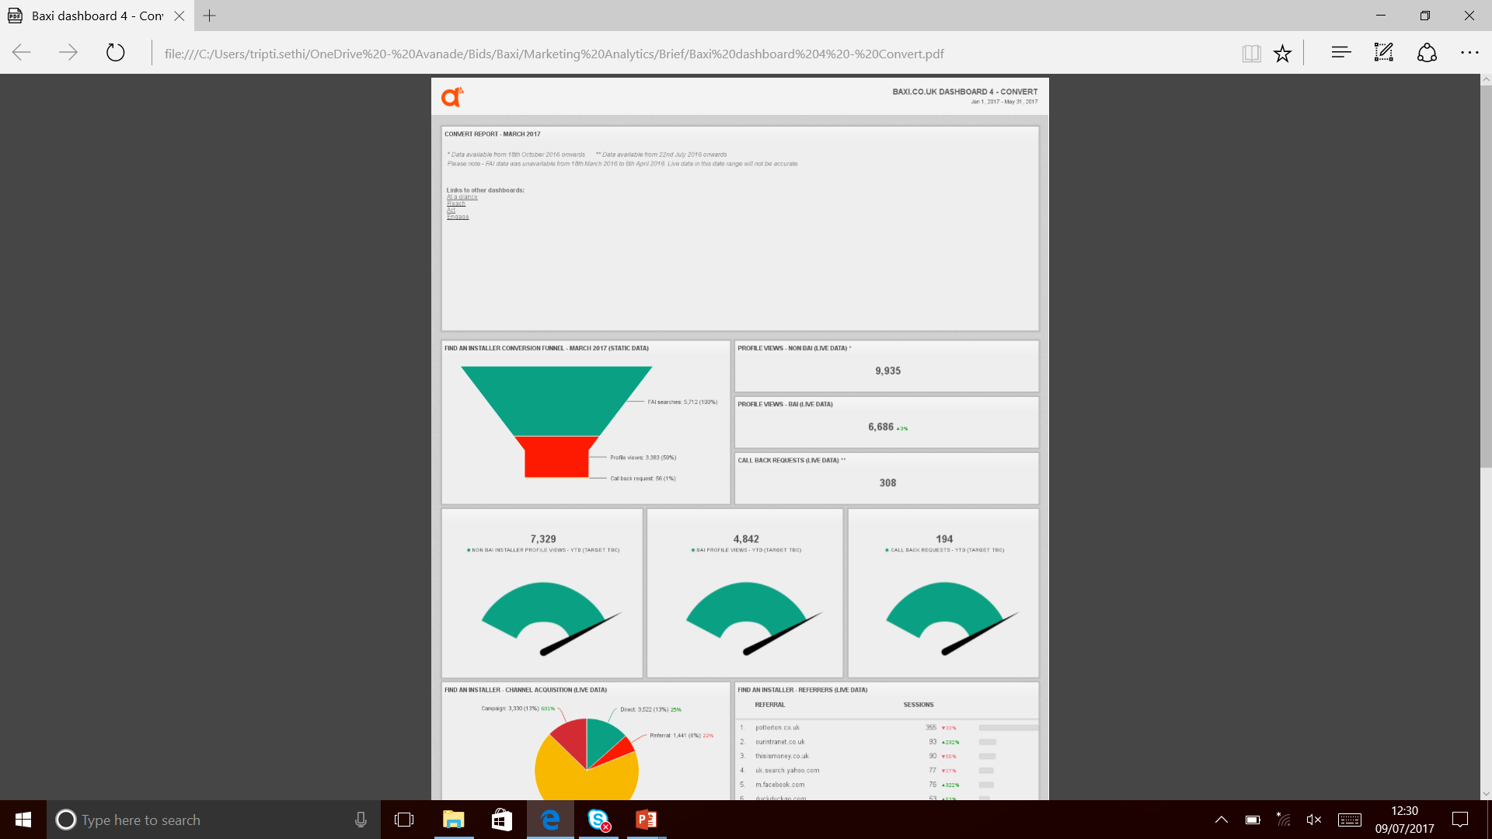
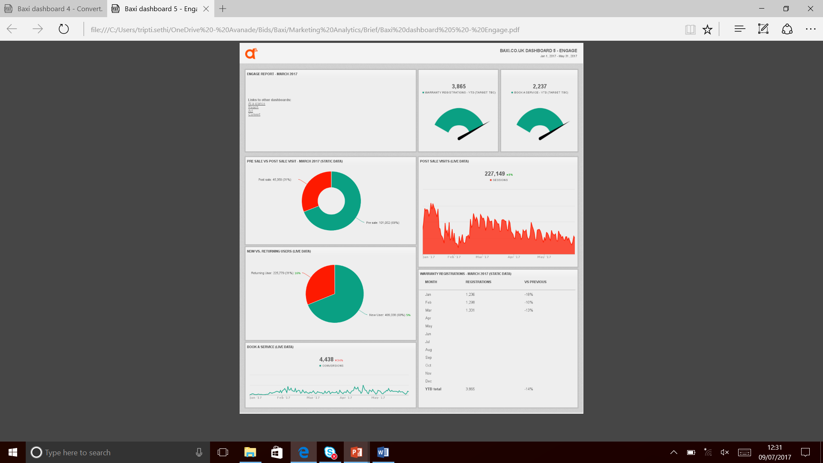
A small, strategic piece paved the way for the Big Picture
Sitecore Implementation
IOT Data in the Cloud
Predictive Analytics
Digital Framework
Marketing Analytics
Notes:
Identify Models with Poor Performance
Create job requests before a Customer calls
Create new warranty programs based on appliance performance
Predictive Maintenance
Alert Landlords of boiler failures
Alert Customer Service in real-time when Baxi receives poor sentiment
Proactively offer promotions or services to customers based on sentiment
Customer Sentiment
Gain visibility of where servicemen are located, their inventory and skill, and match to nearest requests
Assign jobs to field automatically, based on demand and up-coming maintenance jobs
Connected Field Service
Consider other areas in your business that have a problem that can be solved with science
Is there an appetite for support at budget time for Predictve Analytics projects?
For example:
Use near real-time performance data of connected appliances to predict expected requests based on appliance performance
Analyse what your customers are saying about you online and use that to increase/maintain customer satisfication, like…
Several customers in the South East region are complaining via Facebook and Twitter that their serviceman is extremely late. Real-time alerts may be sent to customer service so that they may call the customers and provide them options of discounts, rescheduling, or re-routing a different serviceman for a same-day appointment, as well as providing an opportunity for customer service to proactively reach out to the South East region to find out what’s going on.
For appliances that will be connected to internet (IoT), use predictive maintenance to identify parts, drivers, and generate service calls on behalf of your customers
If we guage the room and ask everyone what their next steps as part of wrap up, what would they like Customer Service to do next?

Slide 51

Global cleaning products vendor increases sales and customer loyalty with predictive intelligence
Challenge: Maintain sales levels year-over-year.
Solution: Using machine learning algorithms, Avanade discovered that when customers purchased and installed less of certain products, their risk of failing a health inspection went up significantly. Given that such incidents have the potential to cost their customers tens of thousands of dollars per location, this intelligence was of significant value to both parties.
Results:
The model was able to predict inspection failures with 90% accuracy.
By communicating to customers the measurable importance of maintaining order levels, the vendor arrested falling year-over-year product sales.
Taking proactive steps to help customers pass health inspections could significantly increase loyalty and retention by saving the customers large sums of money each year.
51

Slide 52


Premium Car Brand
Predictive Maintenance on camshaft drive chain failures
Big Data Platform to ingest, analyze and process massive car sensor data
Predict extensions of camshaft drive chains and identify potential root causes
Recommend predictive maintenance action to replace or adjust camshaft driving chains during routine workshop
Increased Customer Satisfaction
Realized cost savings through predictive maintenance
Reduce visits to save costs, warranty cases and increase customer satisfaction
52
Notes:
1 TB Sensor Data (XML of Workshop protocols)
Mashup with environment data like weather Data available on Azure
Technologies
Data Processing: Microsoft Azure Big Data (HDInsight, Azure SQL, Azure Data Factory, Spark)
Analytics: Azure ML
Visualization: Power BI
Identification of relevant (true) indicators of camshaft drive chain failures Root-Cause Analysis based on Two-Class Logistic Regression and Two-Class Boosted Decision Tree
- Pearson correlations between influencing factors and VANOS values
Prediction of camshaft drive chain failures and guarantee cases : Predictive Modeling based on Two-Class Logistic Regression and Two-Class Boosted Decision Tree
- models with the 7 days time lag for enabling preventive actions before failure
Finding unknown valuable patterns in the data
Methods:
- explorative analysis of VANOS values of cars with mileage up to 100 km
- explorative analysis of VANOS values after a presumable camshaft drive chain replacement
Analysis aim
Predict the exceedance of the VANOS value threshold (camshaft drive chain failure) using the factor profile including static car data, test measurement results and mileage information from the previous workshop visit (taking the 7 days time gap into account)
Data sample
71 cars with VANOS value threshold exceedance, 710 cars without VANOS value threshold exceedance (pulled randomly from the sample with 6485 cars for the matter of increasing the proportion of targets with 1-value in the sample)
Statistical methods of analysis
Two-Class Boosted Decision Tree
Two-Class Logistic Regression
Analysis steps
- Format adjustment
- Target variable labeling
- Column selection
- Sample splitting
- Predictive Modeling (optional: Pearson Correlation Analysis)

Slide 53
Thank You!

